Slide 1


Slide 2
Ascentis Qualifications for the future
ESOL – what's new?
English & Maths – a fresh approach to Functional Skills
Access to HE – new diplomas and revalidation
Short Online Qualifications – engaging themes for your learners

Slide 3
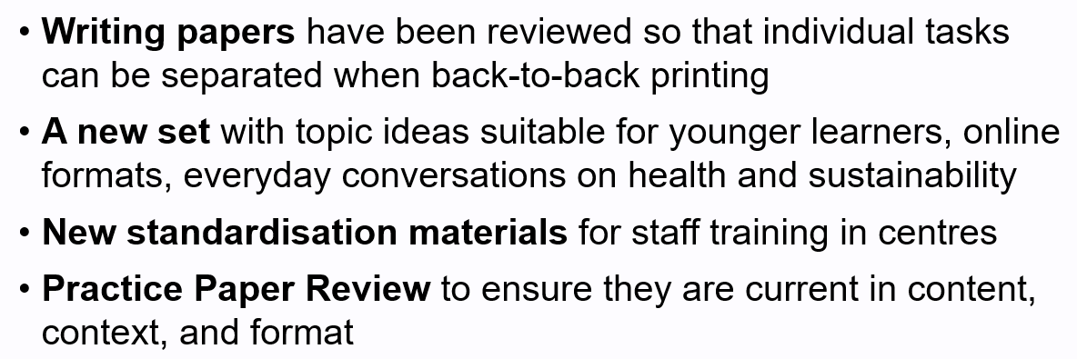
ESOL – what's new

Slide 4
ESOL – what’s new
Reading Online Assessments and Practice Paper, currently available at E1, through to L1
Identical to the paper-based assessments with the added benefits:
  Secure online platform, Surpass
  Automatically marked on Surpass
  Enable learners to practise and employ digital skills
Expanding the online offer at L2 & adding a practice set

Slide 5
ESOL – what’s new
New example videos for staff
Samples of real Speaking assessments as they were recorded on the day at Ascentis centres
Being authentic, they are ‘examples’ not ‘exemplars’, and this is to stimulate discussion amongst teachers
Examples of how to conduct assessments, not how to mark them, and come with a short commentary document
For centre staff training only

Slide 6
ESOL – what’s new
A new partnership with Metaverse Learning
Interactive learner resources mapped to Ascentis assessments for your learners
Metaverse stand in foyer for demos during the day

Slide 7
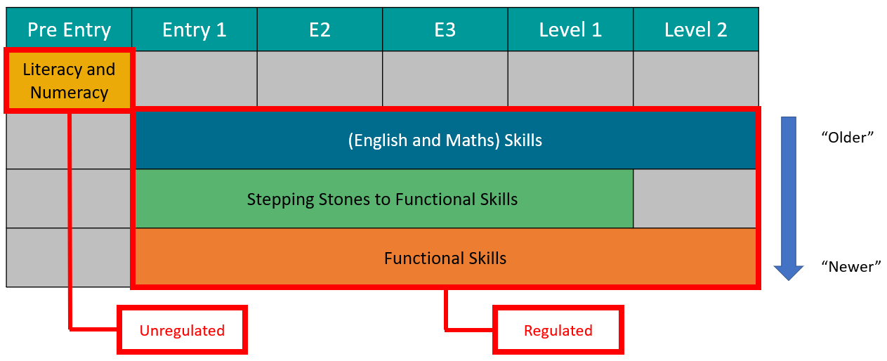
English & Maths – a fresh approach to Functional Skills

Slide 8

English & Maths – a fresh approach to Functional Skills
Born-digital online assessment
Accessible and scalable for different cohorts

Slide 9
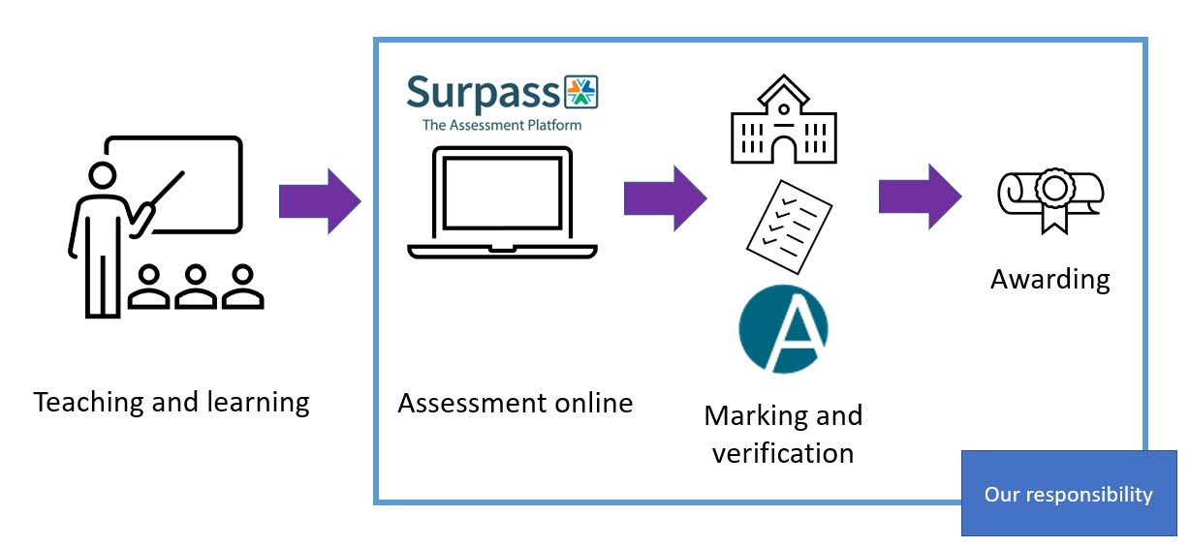
English & Maths – a fresh approach to Functional Skills

Slide 10
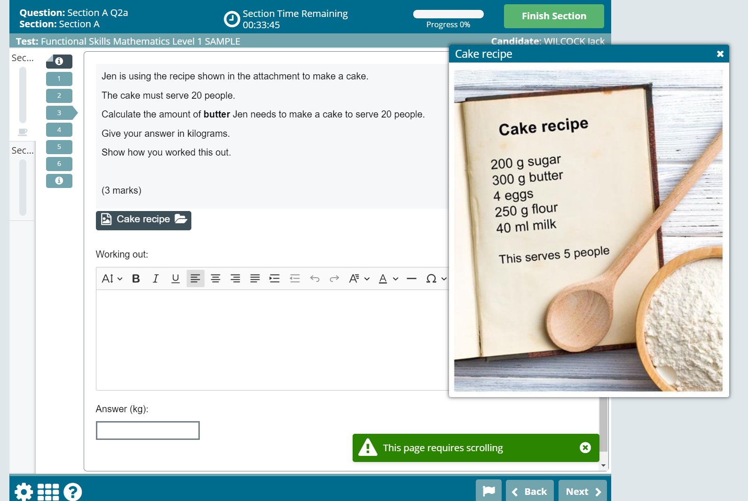
English & Maths – a fresh approach to Functional Skills

Slide 11
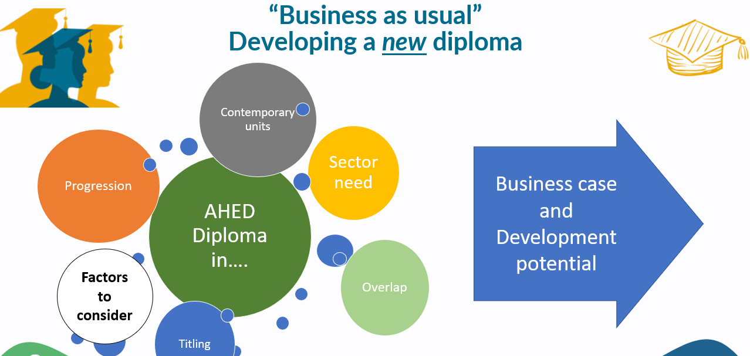
Access to HE – new diplomas and revalidation

Slide 12
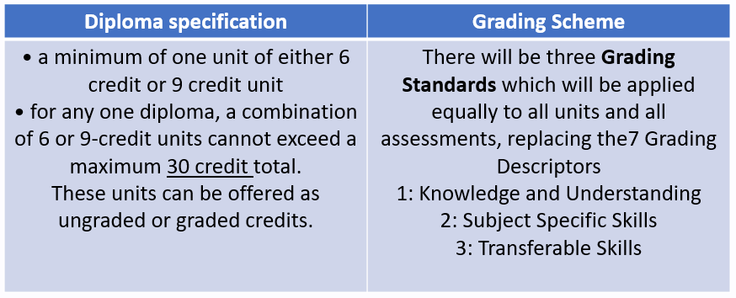
Access to HE – new diplomas and revalidation

Slide 13
Access to HE – new diplomas and revalidation
We will be considering QAA regulatory changes in addition to centre comments, usage and contemporary changes within panels
We will aim to
Maintain academic rigour
Address and embed contemporary content
Identify and develop strong progression pathways

Slide 14
Short Online Qualifications – engaging themes for your learners
SOQs provide extra certification, boost confidence, help to increase centre success rates, and provide learners with vital life skills. With 29 titles to choose from, popular topics for learners include:
Entry 3 Award in Introduction to British Values
Level 1 Award in Citizenship
Entry 3 and Level 1 Awards in Equality & Diversity
Level 1 Award in Managing Personal Finance
Level 1 Award in Mental Health & Wellbeing
Our e-Invigilation platform allows learners to complete a multiple-choice e-Assessment remotely. Provisional results are instant and rapid certification turnaround ensures your learners have the qualifications in time to prepare for life outside the learning environment.

Slide 15
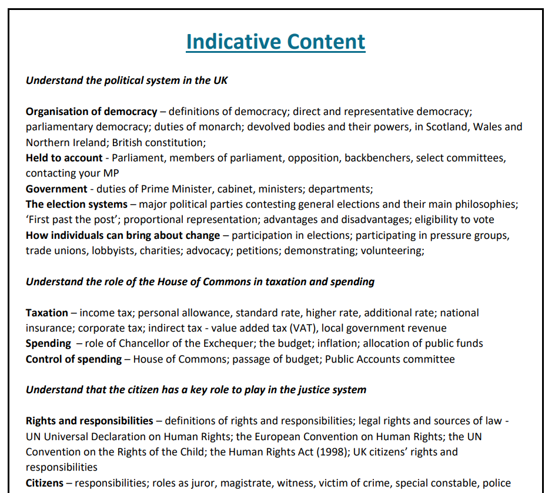
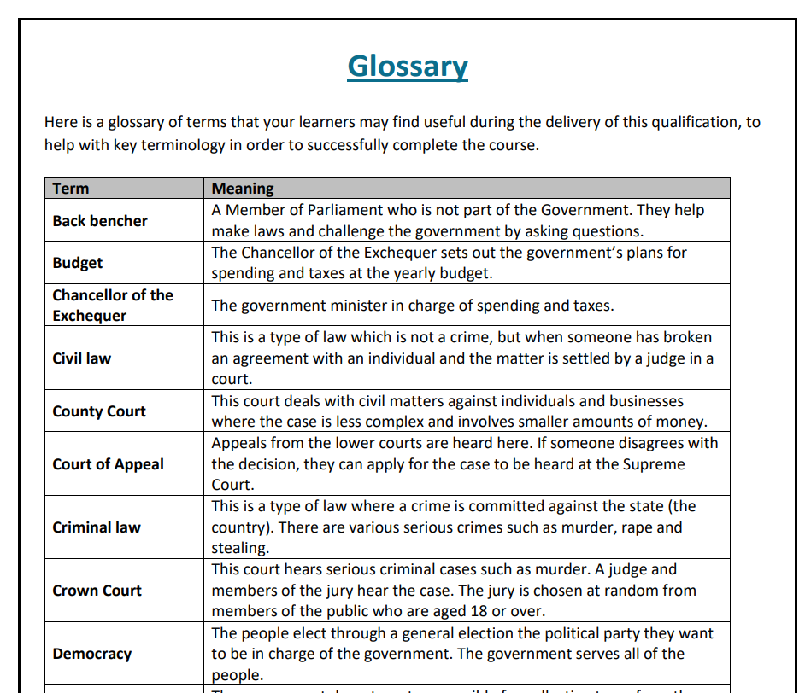
Short Online Qualifications – engaging themes for your learners
Free interactive online resources including indicative content, useful websites, sample questions, and a glossary at the level below:

Slide 16
Questions
Alexander.Houghton@ascentis.co.uk
National Account Manager

